Slide 1
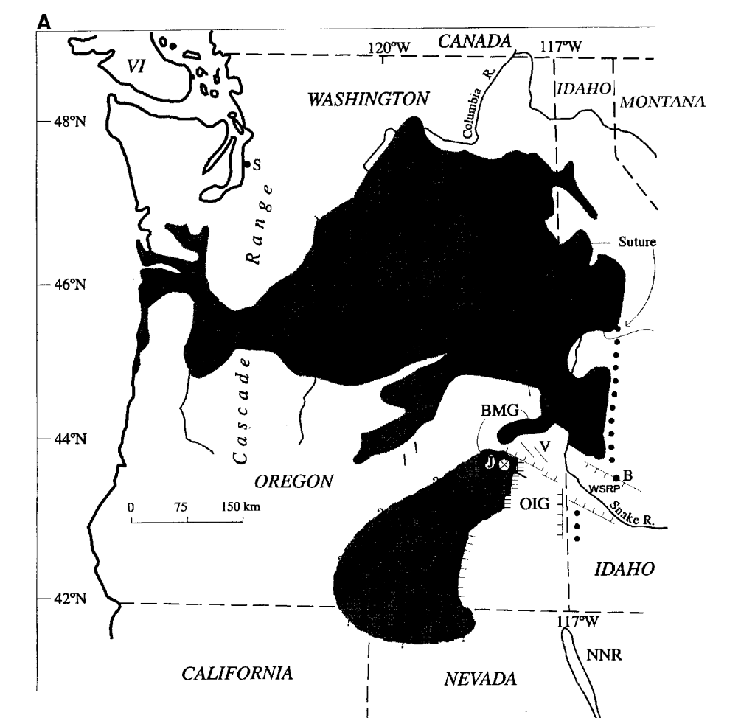
Volcanic Stratigraphy of Steens Basalt and Columbia River Flood Basalt
Hooper Et Al 2002
Ryan Parkyn

Slide 2
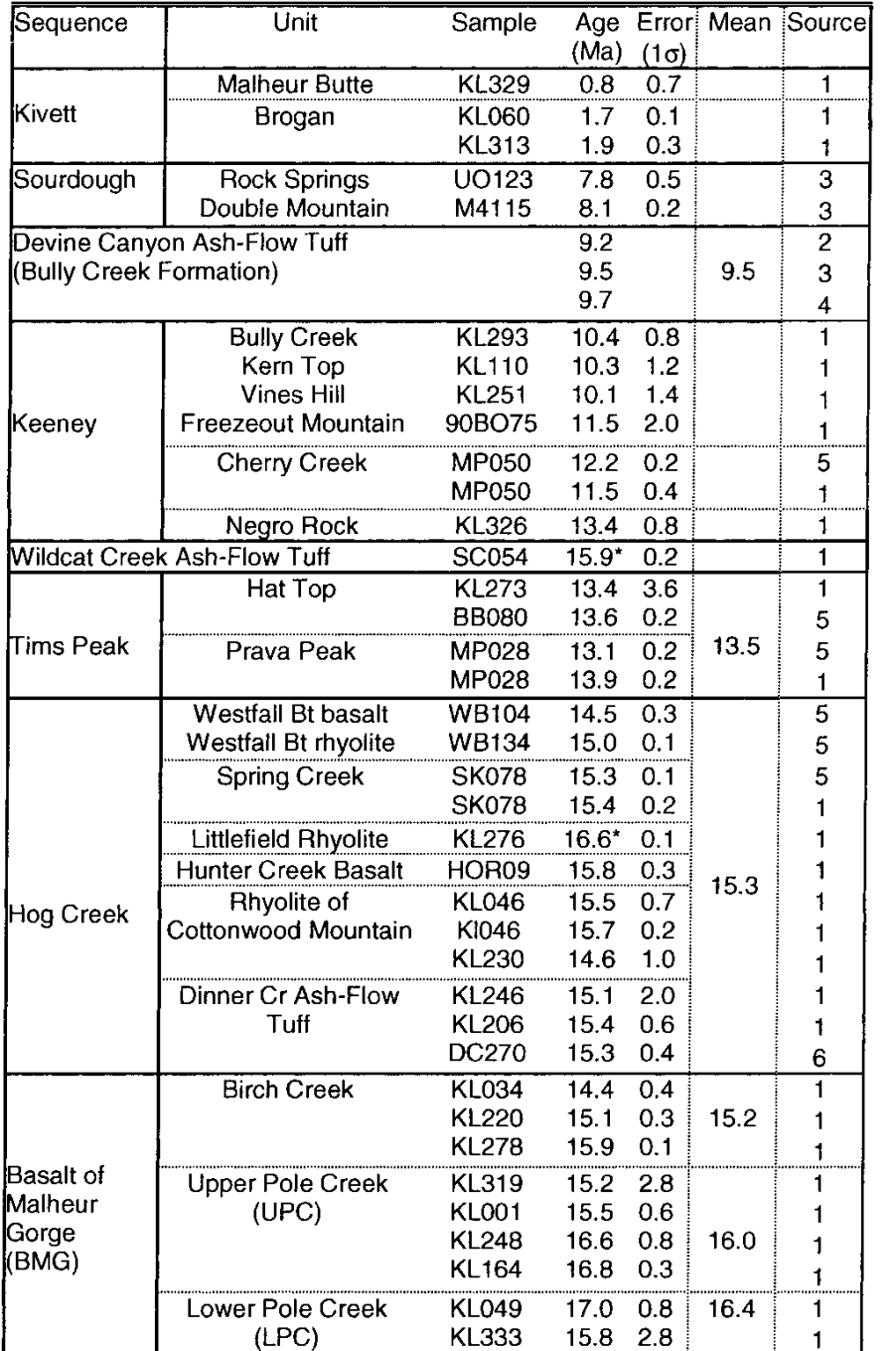
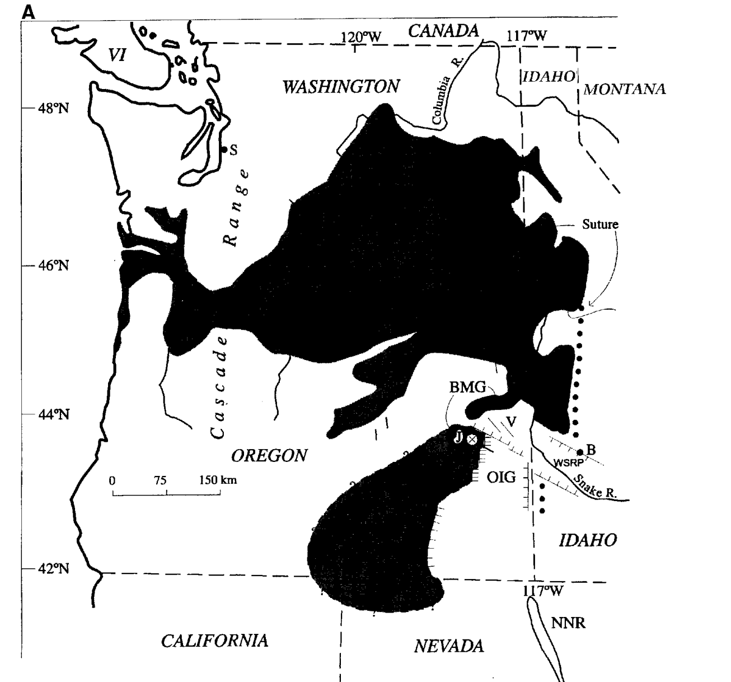
Study Area
CRBG - Columbia River Basalt Group
BMG - Basalt of Malheur Gorge
WSRP - Western Snake River Plain
OIG - Oregon-idaho Graben
Notes:
Figure 1. (A) Regional sketch map showing the distribution of Miocene flood basalts in the Pacific Northwest.
These include the Steens Basalt, the basalt of Malheur Gorge (BMG), and the Columbia River Basalt Group (CRBG).
Note that the Steens Basalt may have been displaced to the west by posteruptive east-west extension that formed the Oregon-Idaho graben (OIG) and by oblique right-lateral movement along the western Snake River Plain (WSRP) (Hooper et al., 2002).
B—Boise,
J—Juntura and Malheur Gorge, cut by the west-northwest–trending Malheur Gorge fault, NNR—North Nevada rift
S—Seattle,
SB—Squaw Butte,
SM—Steens Mountain,
V—Vale fault zone,
VI—Vancouver Island,
W—Wallowa Mountains (horst).
‘‘Suture’’ refers to the Idaho suture zone, a lithospheric boundary in Idaho and Washington between the older, thicker, North American craton to the east and north and the Blue Mountains accreted oceanic terranes to the west (Armstrong et al., 1977; Fleck and Criss, 1985).

Slide 3
Study Area
Authors reconsidered stratigraphic relations based on newly collected basalt ages (Ar-Ar)
Plotted major element data to differentiate igneous rocks
Notes:
(B) Cartoon of stratigraphic relationships among the Steens Basalt, the basalt of Malheur Gorge (including LPC—Lower Pole Creek, UPC—Upper Pole Creek, and Birch Creek) and the formations of the Columbia River Basalt Group (CRBG) between Steens Mountain and the Columbia Plateau. Not to scale.

Slide 4
Oldest to Youngest Stratigraphic Relationships within Malheur Gorge
Chemically equivalent to Grade Ronde aphyric basalt
More evolved tholeiite with higher Al, K, Ba, Rb, Zr
Porphyritic basalt (plagioclase)

Slide 5
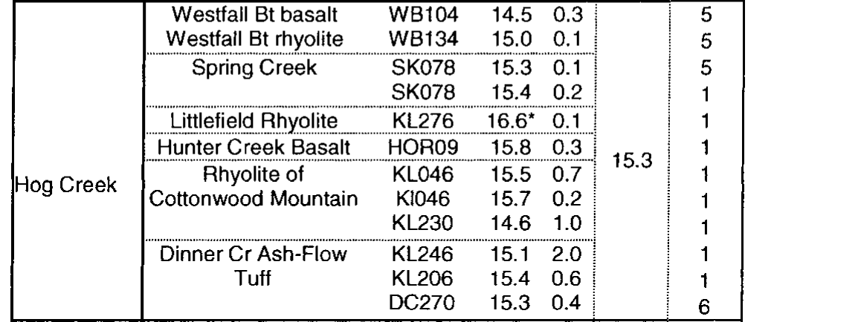
Silicious = various magma trace compositions of crustal melts, volcanics contemporaneous with Oregon-Idaho Graben opening
Genetically the last gasp of tholeiitic magma, aphanitic basalt

Slide 6
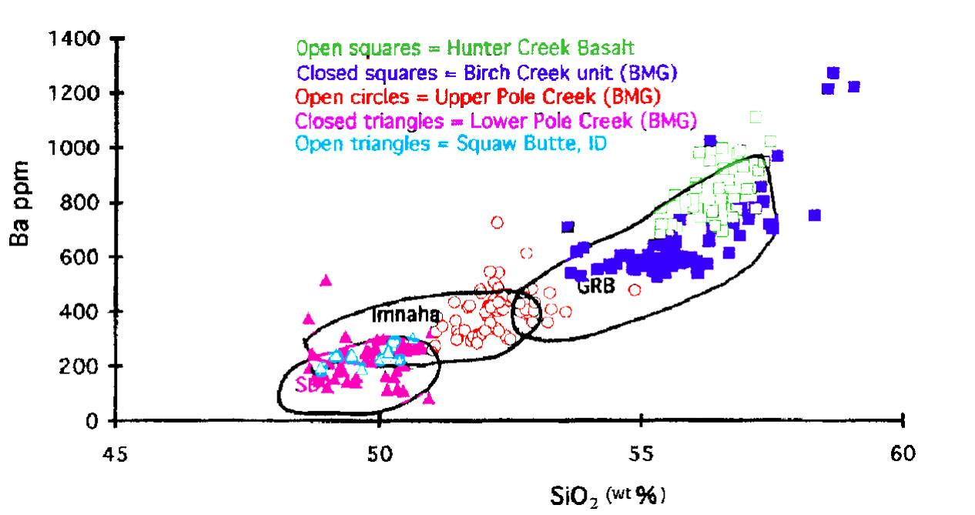
Basalts within Columbia River Plateau are genetically related
Notes:
Ba = incompatible, positive relationship to increasing sio2 content, increases in concentration as melt crystallizes
SiO2 = incompatible
^ Illustrates fractional crystallization

Slide 7
Aphanitic olivine basalt, chemical trends mark the end of the primitive calc-alkalic sequences. Numerous basalt sources in OIG (REEs)

Slide 8
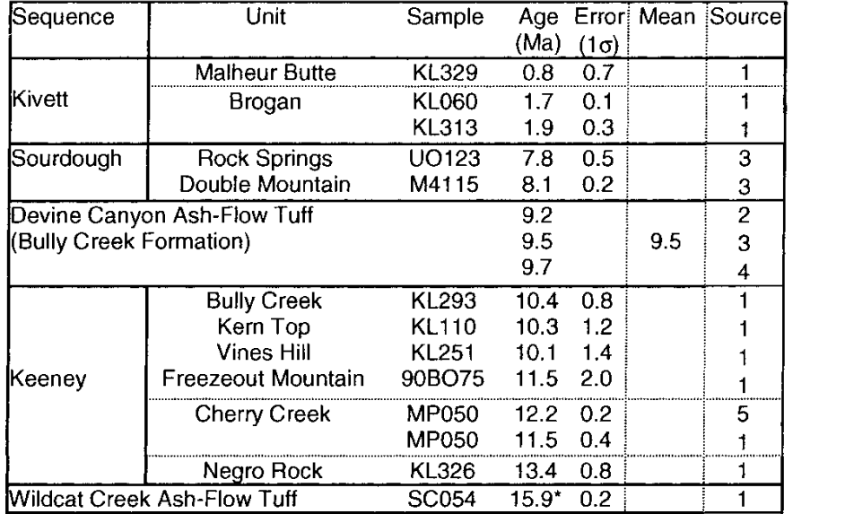
Volcanic vents of andesite and alkali basalt along faults of Vale fault zone, composition similar to Keeny Seq.
Flows of Ol. basalt capping underlying unit
Calc-alkalic/Midly alkalic basaltic andesite separated by thick terrestrial sediment accumulating in grabens

Slide 9
Melts become more evolved going up the stratigraphic sequence
Calc Alkalic Sequences:
DC—Devine Canyon Ash-Flow Tuff
WC— Wildcat Creek Ash-Flow Tuff.
DCT—Dinner Creek Ash-Flow Tuff
CWR—rhyolite of Cottonwood Mountain
LR—Littlefield Rhyolite
WB-1 and WB-2—two ignimbrites in the Westfall Butte Complex
Tholeiite vs Moderately Calc-Alkalic
Tims Peak Basalts vs Keeny Sequences
Notes:
DC—Devine Canyon Ash-Flow Tuff
WC— Wildcat Creek Ash-Flow Tuff.
DCT—Dinner Creek Ash-Flow Tuff
CWR—rhyolite of Cottonwood Mountain
LR—Littlefield Rhyolite
WB-1 and WB-2—two ignimbrites in the Westfall Butte Complex
Plots illustrating the consistent differences in chemical composition between volcanic units in east-central Oregon
If the trend on the Sr vs. Ba Harker diagram shows an abrupt increase in both Sr and Ba: enrichment of crustal melt material as magma differentiated
Sr: Plagioclase feldspar, which is rich in calcium. Sr can substitute for Ca²⁺. As plagioclase crystallizes, the Sr content in the melt decreases.
Ba: Barium is more likely to remain in the melt unless K-feldspar or biotite starts to crystallize. leading to a decrease in Ba in the residual melt.
Positive Correlation: If both Sr and Ba increase together as SiO₂ increases (or in more evolved magmas), this suggests that neither Sr nor Ba is being efficiently removed by crystallizing minerals, and both are incompatible at that stage of magmatic differentiation.
B)
The TiO2 vs. Zr plot distinguishes the more primitive Tims Peak Basalt from the various basaltic andesites and andesites of the Keeney sequence. The plot also distinguishes flows from the geographically distinct eruptive centers of both the Tims Peak Basalt and the Keeney basaltic andesite centers.
Tims Peak Basalt:
GF—Grasshopper Flat type,
HT—Hat Point type,
JG—Juniper Gulch type,
PSR—Pence Spring Reservoir sill.
Keeney sequence:
CC—Cherry Creek,
FM—Freezeout Mountain,
GSR—Gray Stud Reservoir,
NR—Negro Rock,
SC—Spring Creek,
SS—Skull Spring,
VH—Vines Hill,
WC—Wire Corral,
WS—Willow Springs.
Zirconium (Zr) tends to remain in the melt during early and intermediate stages of fractional crystallization. starts to crystallize in the late stages of magmatic evolution. Once zircon crystallizes, Zr is removed from the melt, causing the Zr content in the melt to decrease.
Titanium (TiO₂) is incompatible in the early stages of magmatic differentiation but becomes compatible when Fe-Ti oxides like ilmenite (FeTiO₃) or magnetite crystallize. This usually happens at intermediate stages of magmatic differentiation, meaning TiO₂ concentrations can start decreasing in the melt earlier than Zr.

Slide 10
Notes:
(A) FeO*/MgO vs. SiO2 plot demonstrates the iron enrichment that accompanies increasing SiO2 in the tholeiites and the lack of such enrichment in the calc-alkalic sequences. Fe is less compatible and is crystallized early on and not used as much later crystallization; in other words magma is so rich in Fe that it accumulates in melt bc it is not as efficiently removed from melt like Mg (which crystallizes rapidly early on). Also illustrates that there is enough fe to crystallize ilmenite after much of Mg is crystallized
Tholeiitic magmas are characterized by a larger slope Fe-enrichment trend
which contrasts with calc-alkaline magmas that show early Fe depletion in a shallower slope.
This is due to the fact that in tholeiitic magmas, Fe remains in the melt for a longer period during fractional crystallization.
As tholeiitic magmas evolve, silica content increases, and the FeO/MgO ratio increases because Mg-rich minerals crystallize out early, leaving Fe to accumulate in the remaining melt.
In a tholeiitic trend, the FeO/MgO ratio increases with increasing SiO₂ because:
Early crystallization of Mg-rich minerals (e.g., olivine, pyroxene) removes Mg from the magma.
Fe is less efficiently removed from the magma during early crystallization, and therefore, it accumulates in the residual melt.
As fractional crystallization continues, the magma becomes more silica-rich (higher SiO₂), and the FeO/MgO ratio increases due to the preferential depletion of Mg over Fe.
This Fe-enrichment characteristic of tholeiitic magmas distinguishes them from other magmatic trends, such as calc-alkaline trends where Fe is removed earlier, leading to different evolutionary paths.
B) P2O5 vs. TiO2 plot illustrates the higher P2O5 /TiO2 ratio of the calc-alkalic over the tholeiitic trends.
Ti and P are both incompatible elements, basically compares removal rate of apatite (phosphorus bearing mineral) compared to titanite (ti bearing mineral)
P₂O₅ and TiO₂ can help distinguish between different magmatic series (e.g., tholeiitic vs. calc-alkaline).
Tholeiitic magmas tend to show a shallower slope of Fe-Ti enrichment before TiO₂ is removed by ilmenite
Calc-alkaline magmas show an earlier removal of Fe and Ti due to the earlier crystallization of Fe-Ti oxides

Slide 11
Summary
Magma becomes more differentiatec going up straigraphic column -> Steens predecessor to Columbia Basalt
Distinction between two types of magmatism = evidence against former backarc spreading hypothesis
OIG extension followed flood basalts eruption (Yellowstone Hotspot)

